Slide 1
Investor presentation
The LEADER IN SURGICAL AESTHETICS
January 2026

Slide 2
Cautionary Statements
Forward Looking Statements
Certain matters discussed in this presentation and oral statements made from time to time by representatives of the Company may constitute forward-looking statements within the meaning of the Private Securities Litigation Reform Act of 1995 and the Federal securities laws. Although the Company believes that the expectations reflected in such forward-looking statements are based upon reasonable assumptions, it can give no assurance that its expectations will be achieved.
All statements other than statements of historical fact are statements that could be deemed forward- looking statements, including but not limited to, projections of net revenue, margins, expenses, net earnings, net earnings per share, or other financial items; projections or assumptions concerning the possible receipt by the Company of any regulatory approvals from any government agency or instrumentality including but not limited to the U.S. Food and Drug Administration (the “FDA”), supply chain disruptions, component shortages, manufacturing disruptions or logistics challenges; or macroeconomic or geopolitical matters and the impact of those matters on the Company’s financial performance.
Forward-looking statements and information are subject to certain risks, trends and uncertainties that could cause actual results to differ materially from those projected. Many of these factors are beyond the Company’s ability to control or predict. Important factors that may cause the Company’s actual results to differ materially and that could impact the Company and the statements contained in this release include but are not limited to risks, uncertainties and assumptions relating to the regulatory environment in which the Company is subject to, including the Company’s ability to gain requisite approvals for its products from the FDA and other governmental and regulatory bodies, both domestically and internationally;; sudden or extreme volatility in commodity prices and availability, including supply chain disruptions; changes in general economic, business or demographic conditions or trends; changes in and effects of the geopolitical environment; liabilities and costs which the Company may incur from pending or threatened litigations, claims, disputes or investigations; and other risks that are described in the Company’s Annual Report on Form 10-K for the fiscal year ended December 31, 2024, and the Company’s other filings with the Securities and Exchange Commission. For forward-looking statements in this presentation, the Company claims the protection of the safe harbor for forward-looking statements contained in the Private Securities Litigation Reform Act of 1995. The Company assumes no obligation to update or supplement any forward-looking statements whether as a result of new information, future events or otherwise.
Non-GAAP Financial Measures
We may present non-GAAP measures because we believe such measures are a useful indicator of our operating performance. Our management uses non-GAAP measures principally as a measure of our operating performance and believes that these measures are useful to investors because they are frequently used by analysts, investors and other interested parties to evaluate companies in our industry. We also believe that they are useful to our management and investors as a measure of comparative operating performance from period to period. The non-GAAP financial measure presented in this presentation should not be considered as a substitute for, or preferable to, the measures of financial performance prepared in accordance with GAAP.
The Company has presented the following non-GAAP financial measure in this presentation: adjusted EBITDA. The Company defines adjusted EBITDA as its reported net income (loss) attributable to stockholders (GAAP) plus income tax expense (benefit), interest, depreciation and amortization, and stock-based compensation expense.

Slide 3

tHE LEADER IN SURGICAL AESTHETICS
Real Patients, Real Results
Leading developer of surgical technologies used in minimally invasive aesthetic surgical procedures and
Uniquely positioned to address rapid shifts in market following broad adoption of GLP-1 drugs for weight loss
Renuvion® is the only FDA approved device for treatment of loose and lax skin post liposuction and contracting subcutaneous soft tissue anywhere on the body providing durable and transformational results
AYON Body Contouring System™ received FDA clearance in May 2025 and executed commercial launch in September 2025
Submitted 501(k) with FDA in September 2025 to expand label for AYON to add power liposuction – approval anticipated Q1 2026
Expanded international footprint into China and South Korea in 2025
Real Patients, Real Results

Slide 4



Market trends + macro signals
Apyx is uniquely positioned to lead the surgical aesthetics market and capture the growing post-weight-loss demand
Market Trends
Procedural Shifts
Consumer Behavior
GLP-1 therapies expected to exceed $100B by 2030 (McKinsey).
44% of GLP-1 users spend $2K–$5K on aesthetics; 25%+ spend more.
63% of GLP-1 patients are new to aesthetics post-weight loss.
MedSpa revenue down 30% (noninvasive).
Liposuction procedures declined 10.7% YoY (ISAPS).
Lift procedures surged: Upper Body +24.8%, Lower Body +23.5%, Buttock +16%.
Skin tightening is now the #1 requested treatment post-weight loss.
Only surgical procedures provide durable and transformational results.
72% of GLP-1 users report loose skin as their top concern.
Patients want a mix of 'natural look' vs. transformative change.
57% seek treatment within 6 months post-weight loss.
Desire for multi-modality solutions (contour + tighten + restore).

Slide 5
Multi Billion Dollar Global Market Opportunity
Generators ~$2.3B¹
Market opportunity in U.S.
Generators ~$8.5B³
Market opportunity worldwide
Handpieces ~$750M²
Annual market opportunity in U.S.
>$10B
Handpieces ~$1.9B⁴
Annual market opportunity worldwide
~15,000 Total estimated Plastic surgeons, cosmetic surgeons, & dermatologists in U.S.
~55,000 Total estimated plastic surgeons worldwide
~1.5M Procedures annually in U.S.
~343K liposuction procedures
~700K surgical body contouring, neck contouring and wrinkle reduction procedures⁵
>400K non-surgical procedures⁵
~3.6M Procedures annually worldwide
~2.1M Liposuction procedures
~1.5M Non-Surgical procedures
$1B+ Additional U.S. market opportunity now that AYON Body Contouring System approved by FDA
Assumes ~15,000 physicians * $155,000 generator list price
Assumes ~1,500,000 annual surgical procedures * $500 handpiece list price
Assumes ~55,000 physicians * $155,000 generator list price
Assumes ~3,600,000 annual surgical procedures * $500 handpiece list price
Source: International Society of Aesthetic Plastic Surgery (ISAPS) 2024
5. Management estimates’

Slide 6

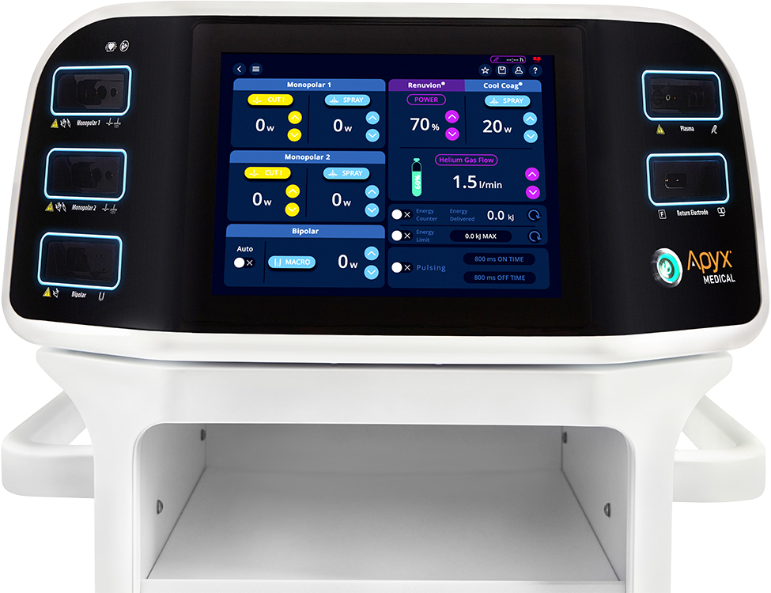

Renuvion Single-Use Handpieces – recurring revenue
Growth Driver over past year
>93,000 surgical procedures were completed using Renuvion single-use handpieces in 2024
Single-use handpiece sales account for more than 60% of revenue for the Surgical Aesthetics business segment in 2024
Current handpiece usages averages approximately 3 per month

Slide 7
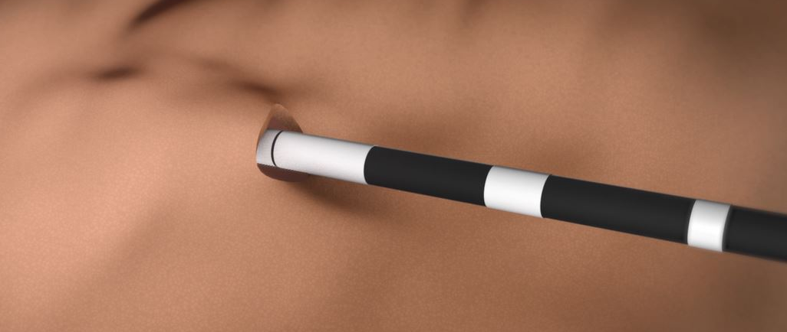
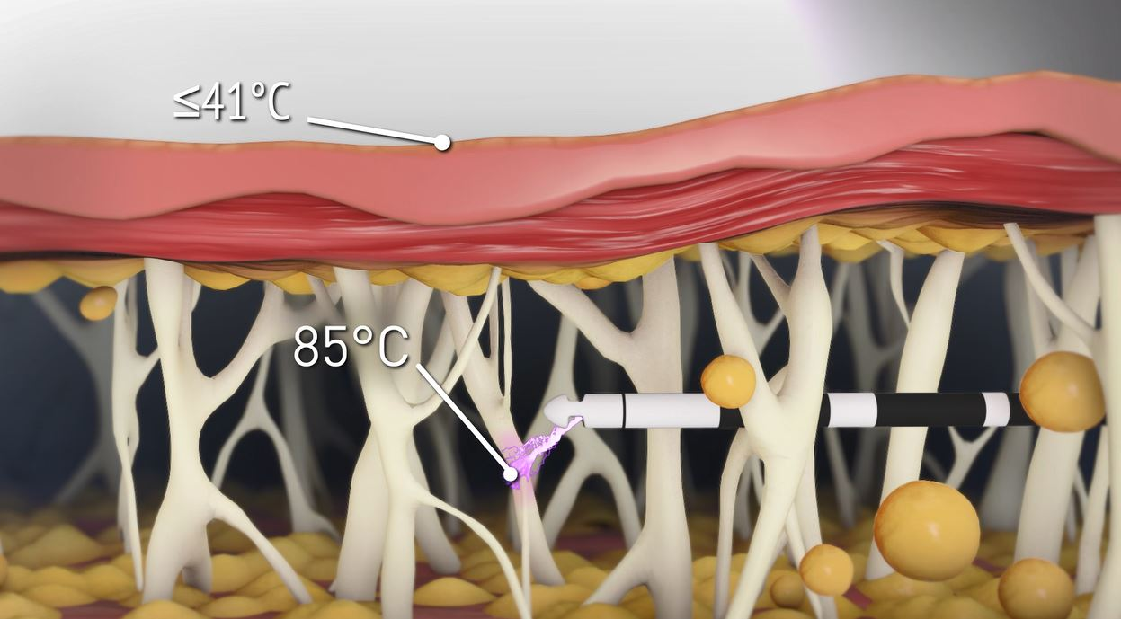
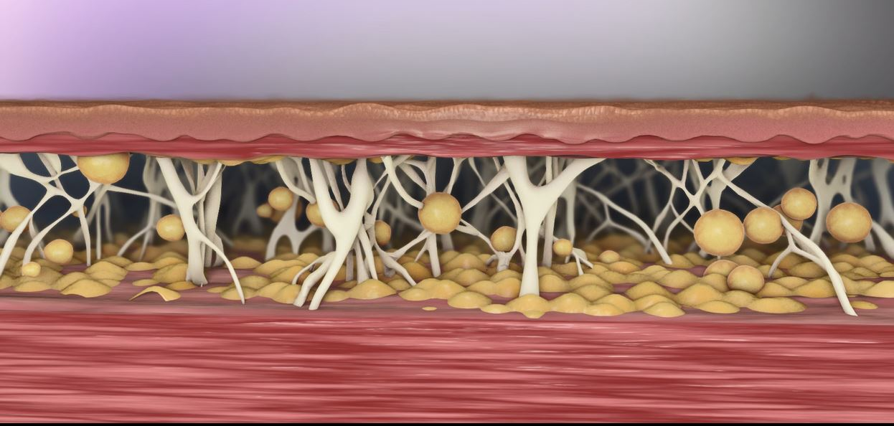
How Renuvion Works
Handpiece inserted sub-dermally
Renuvion® utilizes a unique combination of helium plasma and proprietary radiofrequency energy applied via a single-use wand inserted under the skin. The energy contracts collagen fibers, pulling the skin closer to the muscle for a smooth, contoured appearance in just minutes.
Contract skin via direct heating
Longer-term skin contraction through neocollagenesis

Slide 8

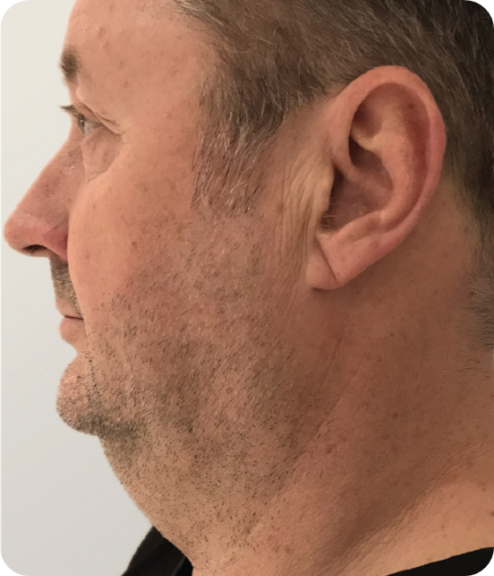
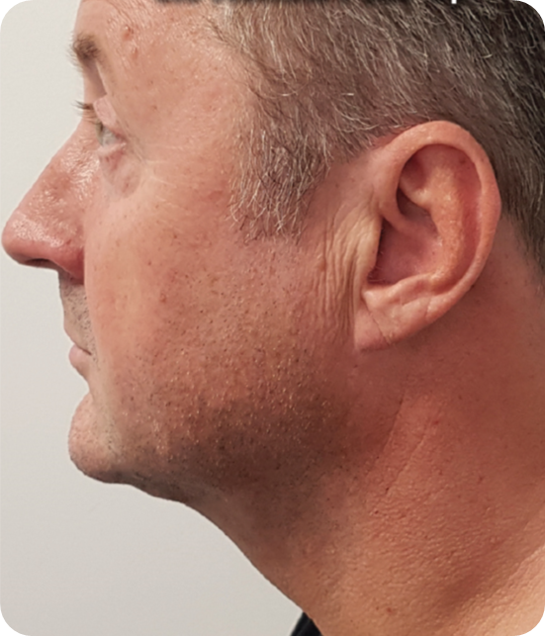
REAL RESULTS
PATIENT
51-YEAR-OLD MALE
PROCEDURE TYPE
LIPOSUCTION + RENUVION®
AMOUNT OF FAT REMOVED
100 ml
BEFORE
5.5 MONTHS POST-OP*
Photos courtesy of Grant Hamlet, MD. *Patient gained 14 lbs since initial procedure

Slide 9
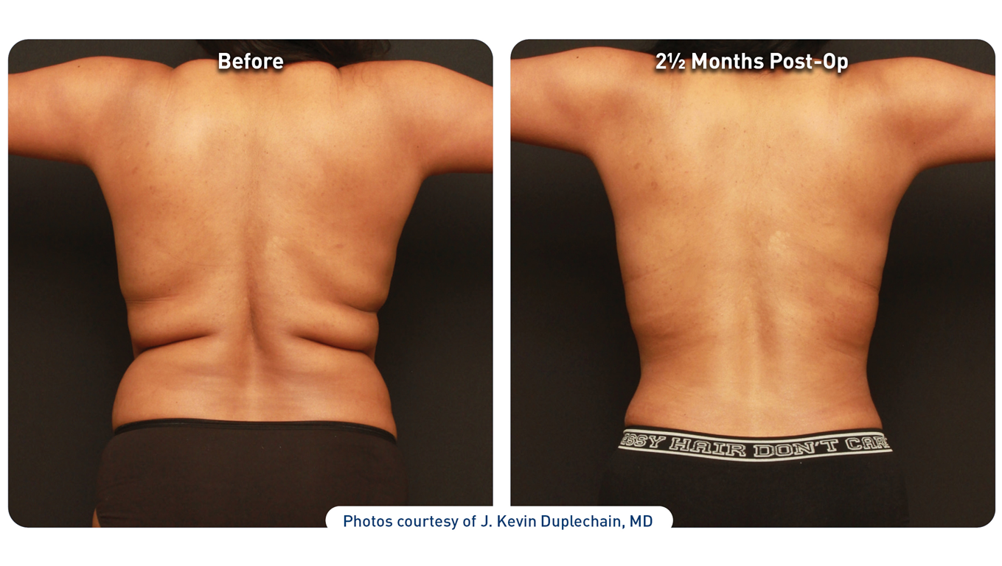
REAL RESULTS
PATIENT
33-YEAR-OLD FEMALE
PROCEDURE TYPE
LIPOSUCTION + RENUVION®
AMOUNT OF FAT REMOVED
1,750 cc
BACK CASE EXAMPLE #1
BEFORE
2.5 MONTHS POST-OP
Photos courtesy of J Kevin Duplechain, MD.
Disclosure: The patient shown in the pictures above is an employee of Apyx Medical.

Slide 10
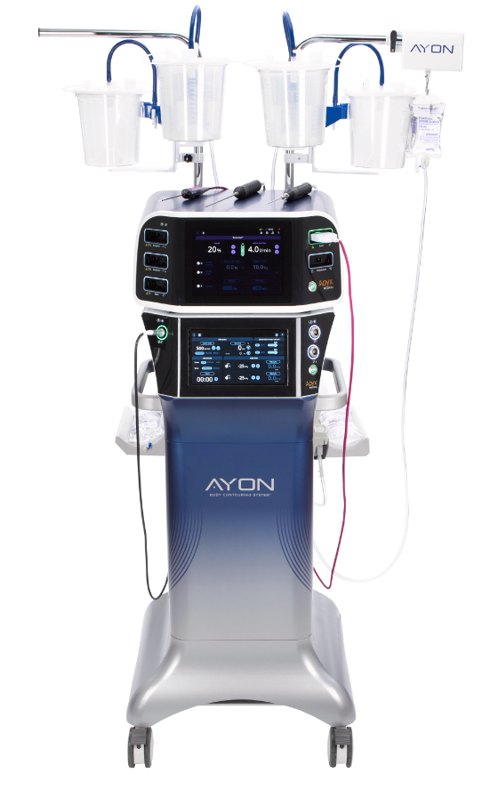
AYON: Revolutionizing Body Contouring
Precise, Superior Results:
AYON’s integrated Lipo Intelligent Frequency Tracking (LIFT) Technology™ offers real-time energy adjustments, ensuring optimal fat emulsification and accurate sculpting.
Comprehensive Treatment:
AYON combines fat removal, transfer, and skin tightening in one system, addressing areas from delicate regions like the neck to larger zones such as the abdomen.
Enhanced Skin Contraction: Renuvion technology delivers firmer, smoother contours by significantly tightening skin post-procedure, particularly in areas with laxity.
All-in-One Platform:
AYON seamlessly integrates Ultrasound-Assisted Liposuction (UAL), Power Liposuction, Renuvion, infiltration, aspiration, electrocoagulation, and fat transfer into a single, streamlined device.
Advanced LIFT Technology™: Automatically adjusts to maintain optimal resonance frequency, ensuring consistent fat emulsification and safe, effective body sculpting.
Improved Workflow Efficiency:
A single console for multiple procedures enhances ease of use, streamlines operations, and provides complete control for a wide variety of treatments. Dual Suction and Aspiration enhance operating room efficiency and improve procedural outcomes by streamlining fat removal and reducing treatment time.
Electrosurgical Capabilities | Infiltration/ Aspiration | Suction Assisted Liposuction | Ultrasound Assisted Liposuction | Power Liposuction Submitted 510(k) September 2025 | Renuvion Skin Contraction | Closed Loop Contouring for Fat Transfer

Slide 11


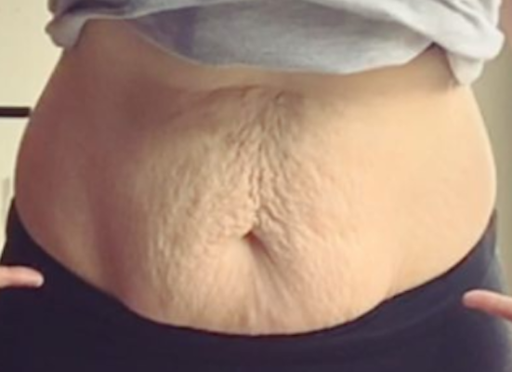
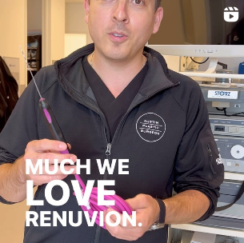
Driving Patient Demand + Optimizing Provider Results
Renuvion DTC & Physician Marketing Strategy
INFLUENCER
MARKETING IMPACT
AMPLIFY AWARNESS THROUGH KEY EVENTS
ADRESSING THE LOOSE SKIN EPIDEMIC
PRACTICE GROWTH + ENHANCING RESULTS
Leveraging partnerships with key influencers to drive patient inquiries and highlight Renuvion’s results with an emotional connection.
Participating in premier lifestyle expos and exclusive retreats to engage consumers and providers, boosting brand visibility and patient demand.
Launching targeted campaigns to educate patients and providers, positioning Renuvion as the #1 trusted body contouring technology focusing on loose skin.
Providing comprehensive marketing resources and digital tools to help providers attract, educate, and convert patients, ensuring optimal treatment outcomes.

Slide 12
Global Presence
Driving growth by expanding customer base and increasing utilization from existing accounts
We are also registered to sell our products through distributors in over 60 countries.
Our manufacturing operations are supported by facilities located in Clearwater, FL, Sofia, Bulgaria and through our contract manufacturing partner in Ningbo, China.
¹ as of December 31, 2023
Driving growth by expanding customer base and increasing utilization from existing accounts
We are also registered to sell our products through distributors in over 60 countries.
Our manufacturing operations are supported by facilities located in Clearwater, FL, Sofia, Bulgaria and through our contract manufacturing partner in Ningbo, China.
Sofia, Bulgaria
Manufacturing facility
Clearwater, Florida
Manufacturing facility
Ningbo, China
Contract Manufacturing facility
¹ as of December 31, 2023

Slide 13
Strategic Initiatives Announced in Q4 2024 – Value Creation in 2025
Completed a registered direct offering with net proceeds of $7.0 million with a healthcare-focused fund
Amended credit agreement with Perceptive Credit Holdings IV, LP
Significantly reduce the trailing twelve-month Surgical Aesthetics revenue covenants
Added a maximum operating expense covenant of $40M and $45M for 2025 and 2026, respectively
Implemented a cost saving restructuring program that included an organizational reduction in force to better focus, optimize and streamline operations:
Reduced U.S. workforce by nearly 25%, with estimated annualized future cost savings of ~$4.3M
Identified over $4M in additional cost savings
Anticipate operating expenses to be below $40 million in 2025
Right sized the Company’s board of directors to five members down from eight, and reduced cash compensation for remaining directors

Slide 14
2025 Financial Preliminary revenue – revised upwards
Preliminary Fourth Quarter 2025 Revenue Summary:
Total revenue is expected to be in the range of approximately $19.0 to $19.2 million, representing an increase of approximately 34% year-over-year.
Surgical Aesthetics revenue is expected to be in the range of approximately $16.6 to $16.8 million, representing an increase of approximately 38% year-over-year.
OEM revenue is expected to be approximately $2.4 million, representing an increase of approximately 13% year-over-year.
Preliminary Full Year 2025 Revenue Summary:
Total revenue is expected to be in the range of approximately $52.7 to $52.9 million, representing an increase of approximately 10% year-over-year.
Surgical Aesthetics revenue is expected to be in the range of approximately $45.2 to $45.4 million, representing an increase of approximately 17% year-over-year.
OEM revenue is expected to be approximately $7.5 million, representing a decrease of 21% year-over-year.
Operating expenses expected to be less than $40 million for the year ended December 31, 2025
Down from $48 million in 2024

Slide 15
2025 COMPANY OBJECTIVES
Continue to execute commercial launch of AYON in September 2025 and capitalize on increased demand for market tailwinds related to GLP-1 drugs
01
04
Continue to develop network outside of U.S.
02
Continue to expand library of clinical evidence supporting the use of our Surgical Aesthetic products
05
Continue to expand adoption of Renuvion® as the revolutionary treatment of loose and lax skin
03
06
Active DTC program to facilitate new customer adoption
Manage expenses while driving progress towards profitability

Slide 16
Q&A
Office Locations
APYX™ MEDICAL CORPORATION
5115 Ulmerton Road • Clearwater, FL 33760-4004 • USA
APYX BULGARIA
Manufacturing Facility and European Authorized Service Center

Slide 17
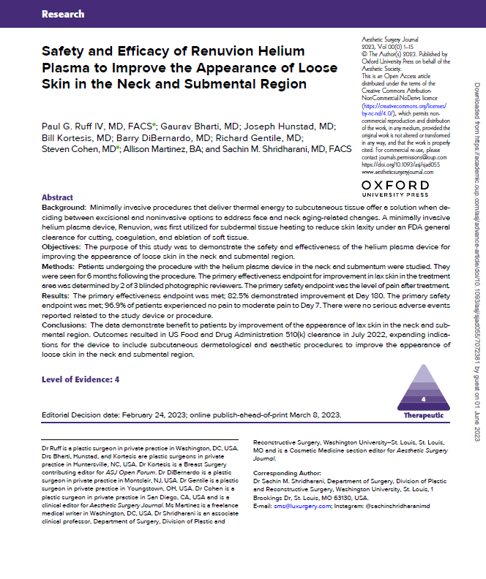
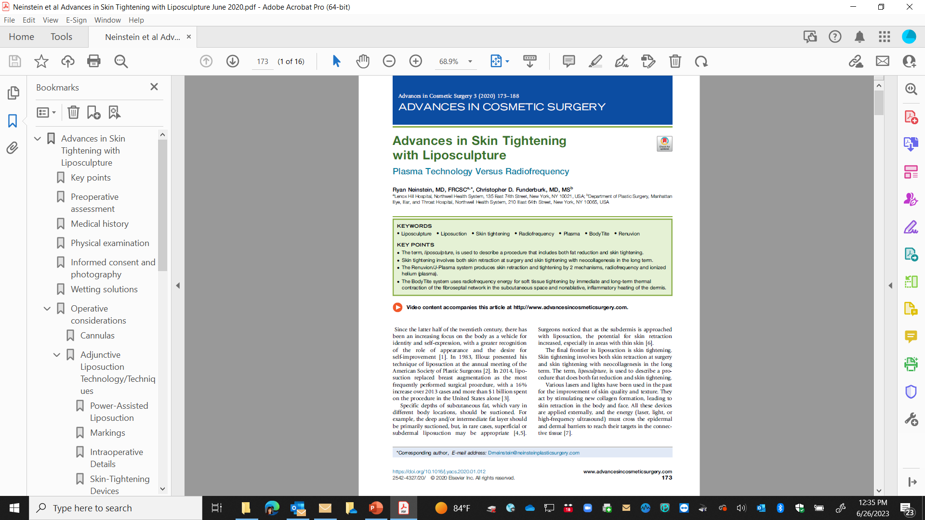
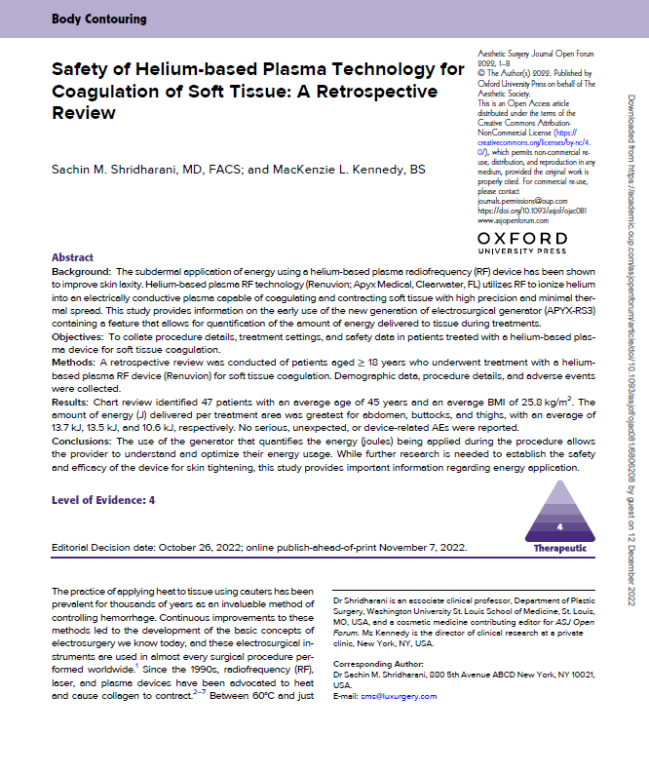
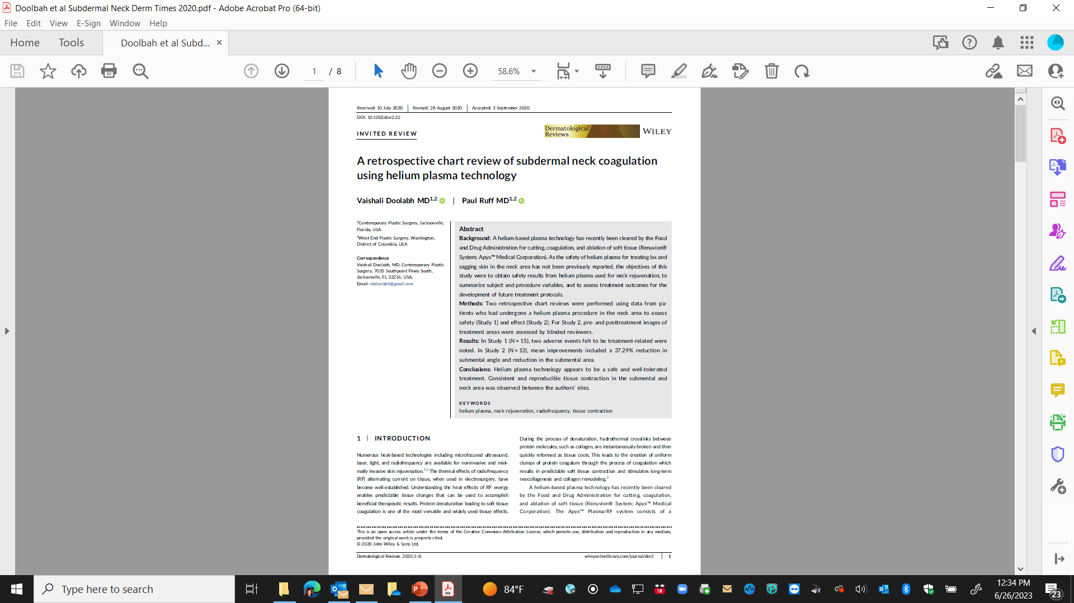
Compelling Clinical and Real-World Evidence
The safety and efficacy of Renuvion is supported by more than 100 published clinical papers, abstracts and posters, as well as 2 multi-site IDE clinical studies.
Clinical Publications at: https://physicians.renuvion.com/library/

Slide 18

BENEATH THE SURFACE
CUTTING-EDGE 3-IN-1 ENERGY SYSTEM: RENUVION® ENERGY AND FULL MONOPOLAR AND BIPOLAR FUNCTIONALITY
INNOVATIVE FEATURES
Adaptive home screen
Intuitive touch screen
Presets by area
CLOUD CONNECTIVITY
Procedural information recording and reporting
Remote system diagnostics
Remote updates
ADVANCED GAS SYSTEM
Measuring and monitoring gas volumes
Sized for 20-60cu/ft tank

